Slide 1
3D Printing Workshop
By: Arti and Liz

Slide 2
Downloading software
ideaMaker slicing software 3.1.7:
→ https://www.raise3d.com/pages/download

Slide 3
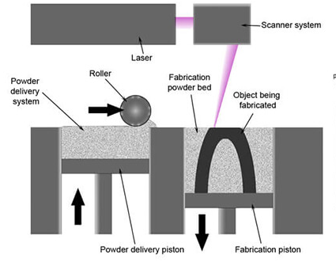
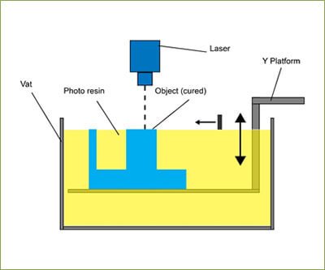
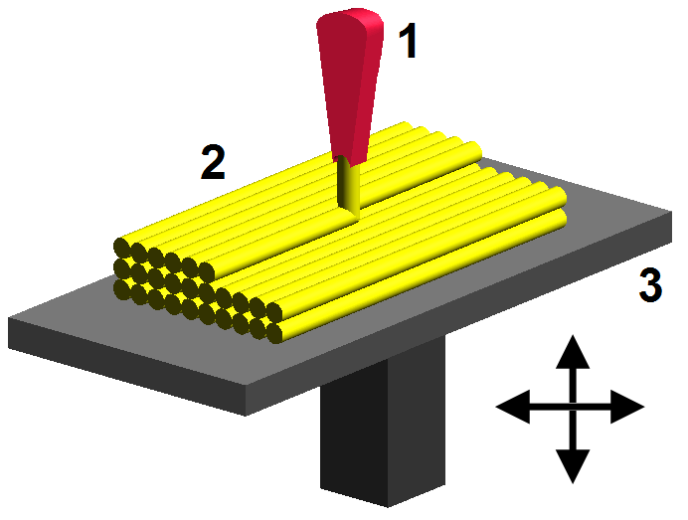
How it works
Additive Manufacturing (layer upon layer of material) aka 3D printing
Vat Photopolymerisation
UV Light cures/hardens resin layer by layer from bottom up
Selective Laser Sintering
Use laser to sinter (heat to form solid mass) metal to bind the material together
Fused Deposition Modeling
Most common, lay material layer by layer w/ filament unwound from coil from extrusion nozzle
Rapid Prototyping + Rapid Development for medical, aviation and hobbyists!

Slide 4


Slide 5
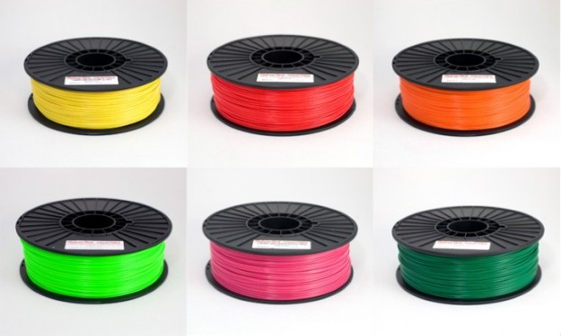
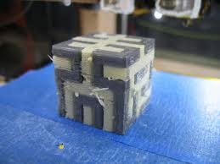
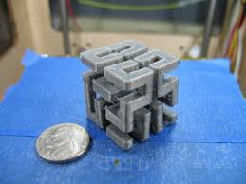
Materials
ABS (Acrylonitrile Butadiene Styrene)
Oil based plastic, stronger and more impact resistant (LEGOs)
PLA (Polylactic Acid)
More brittle plastic, and more ecological -> Packaging Materials
PVA (Polyvinyl Alcohol)
Water soluble plastic, use for support for overhanging issues
Notes:
ABS vs. PLA: https://www.3dhubs.com/knowledge-base/pla-vs-abs-whats-difference#rules-of-thumb
PLA is ideal for 3D prints where aesthetics are important. Due to its lower printing temperature is easier to print with and therefore better suited for parts with fine details.
ABS is best suited for applications where strength, ductility, machinability and thermal stability are required. ABS is more prone to warping.

Slide 6
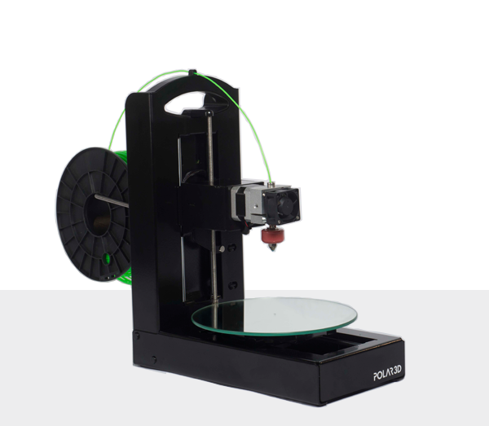
Materials (cont.)
Nylon
Strong durable plastic, interlocking moving parts
Resin
Semi-transparent, rigid but delicate
Steel/metals
For industrial use, requires metal laser sintering

Slide 7
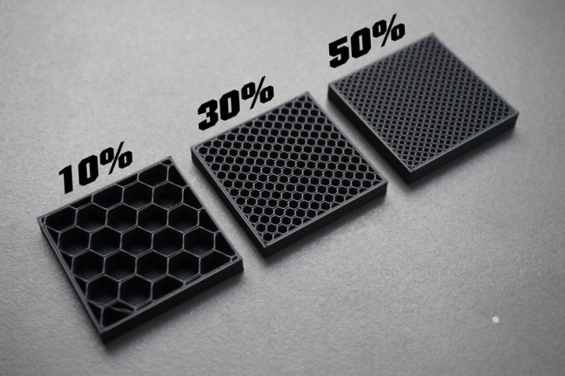
Quick Printing Considerations
Calipers for measurement
Plastic will expand ≅ 2mm (so undershoot)
Print infill, hollow or solid
Depends on your project!
Exposure to UV light, Temp, Water

Slide 8
Autodesk TinkerCAD
Online tool to create fun 3D objects
Combine different shapes together
Easy to use, no setup required!
Great tool for beginners too!
Use an external mouse please

Slide 9
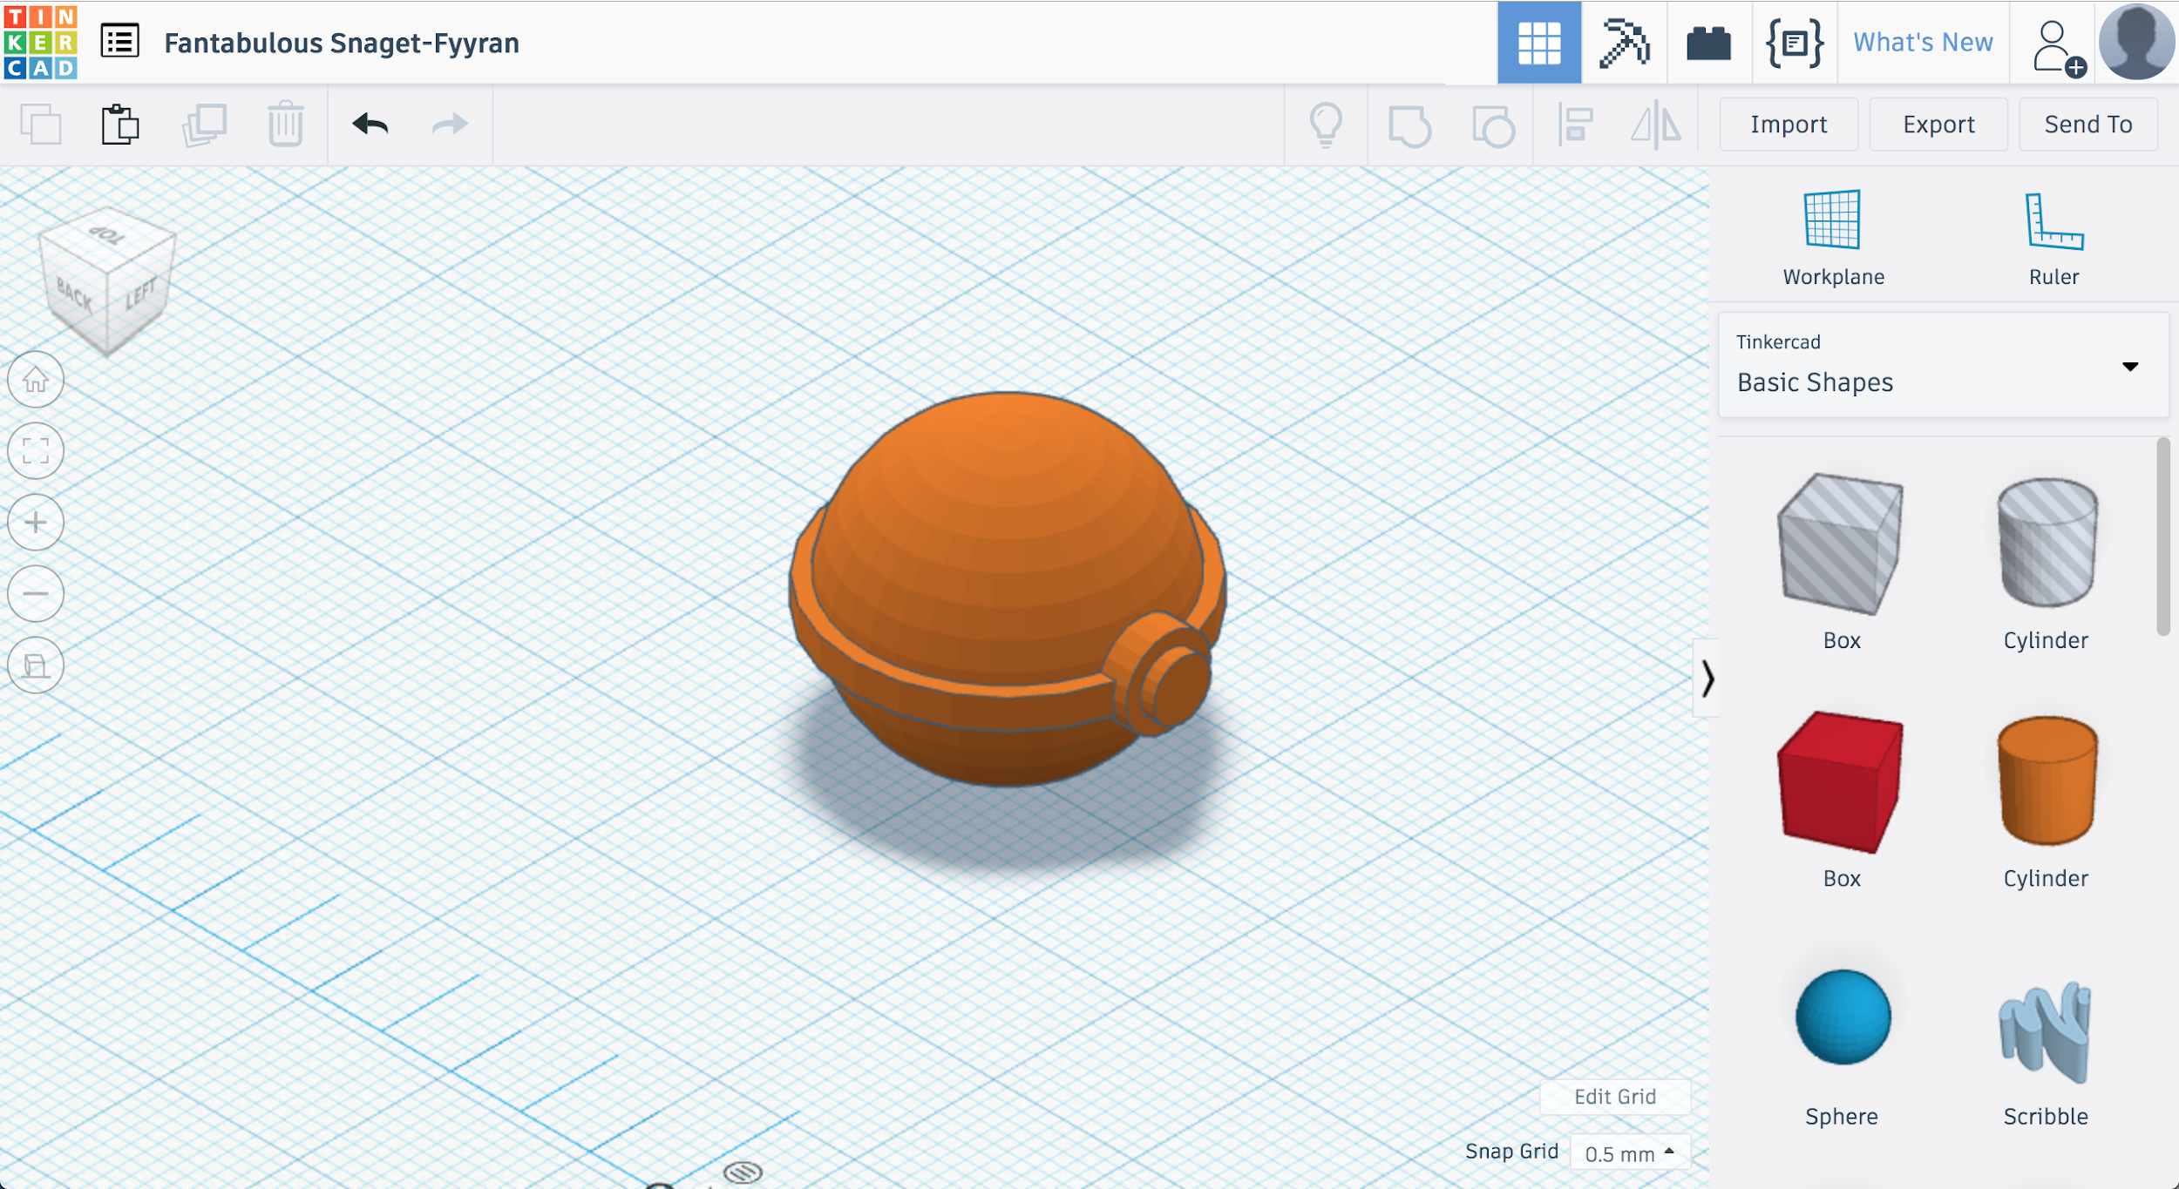

Slide 10
ideaMaker
Slices your models ready for print
Customize your printing experience
Open source and completely free!

Slide 11
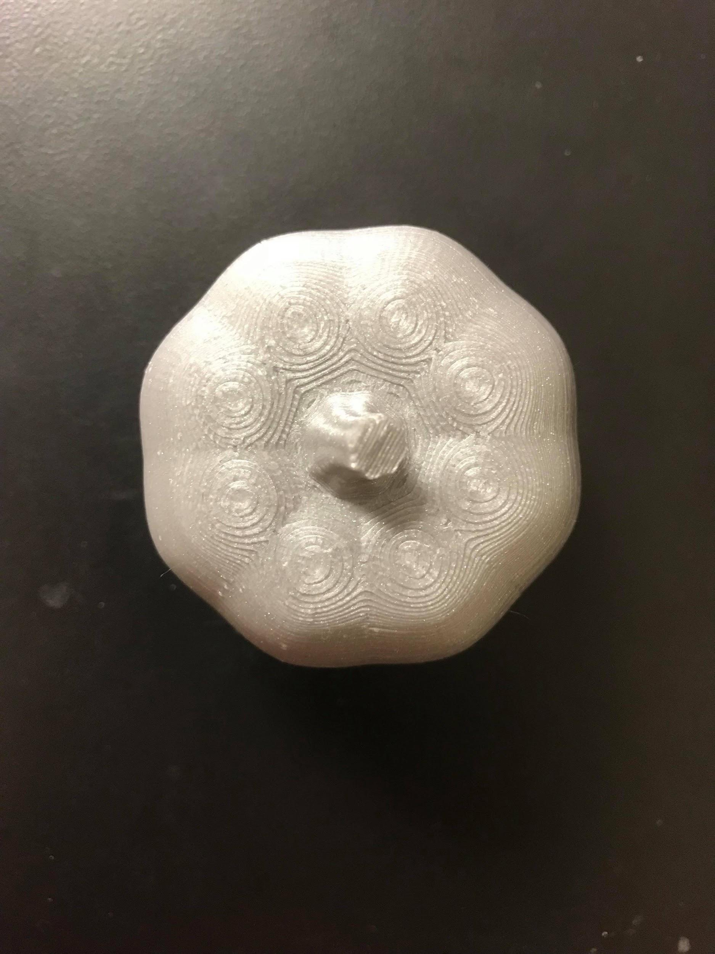

Slide 12
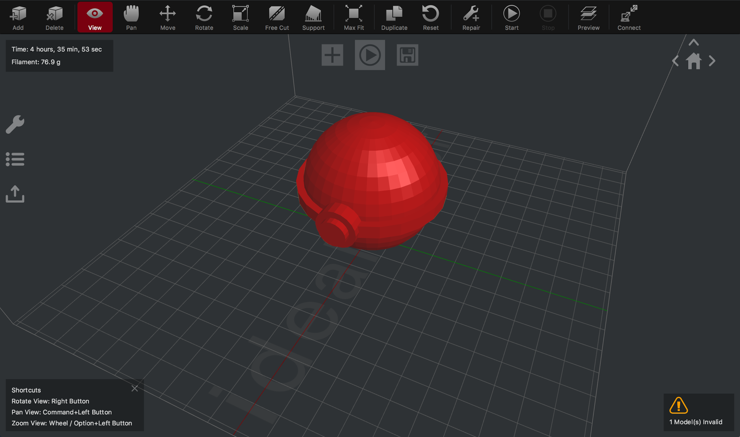

Slide 13
